Slide 1
Chapter 8
Multiplication and Division Revisited

Slide 2
ARM Instruction Execution Times
These instructions are fast compared to some other processors, but may still be several times slower than an ADD, SUB, multiply or shift.
Some other processors don’t have multiply or divide instructions, or their execution time is much greater.
Let’s look at some alternatives.
Instructions | Clock Cycles
PUSH, POP, LDM, STM, LDRD, STRD |  |  | 1 + #regs
SDIV, UDIV |  |  | 2 - 12
Branch (B, BL, BLX, BX) |  |  | 2 - 4
Conditional Branch |  | Successful | 2 - 4
 |  | Failed | 1
All other LDR’s and STR’s |  |  | 2
All other instructions |  |  | 1
Includes ADD, SUB, multiply and shift instructions
ARM® Cortex®‑M4 Processor Technical Reference Manual, Revision r0p1.

Slide 3

MULTIPLYING BY LOGICAL LEFT SHIFT
Positive & Even:
Positive & Odd:
Negative & Even:
Negative & Odd:
+24₁₀ = 00011000₂
? LSL
2×(+24) = 00011000 << 1 = 00110000 = +48₁₀
+25₁₀ = 00011001₂
? LSL
2×(+25) = 00011001 << 1 = 00110010 = +50₁₀
-24₁₀ = 11101000₂
? LSL
2×(-24) = 11101000 << 1 = 11010000 = -48₁₀
-25₁₀ = 11100111₂
? LSL
2×(-25) = 11100111 << 1 = 11001110 = -50₁₀

Slide 4
MULTIPLYING BY A CONSTANT
LDR R0,x // R0 = x
LSL R1,R0,6 // R1 = 64*x
ADD R1,R1,R0,LSL 3 // R1 = 64*x+ 8*x
ADD R1,R1,R0,LSL 1 // R1 = 64*x + 8*x + 2*x
LSL R1,R0,5 // R1 = 32*x
SUB R1,R1,R0,LSL 1 // R1 = 32*x – 2*x
LSL R1,R0,1 // R1 = 2*x
SUB R1,R1,R0,LSL 4 // R1 = 2*x – 16*x
SUB R1,R0,R0,LSL 1 // R1 = -1*x
SUB R1,R1,R0,LSL 4 // R1 = -16*x-1*x
Decimal Constant | 8-bit Binary Representation | Optimal Decomposition
+74 | 01001010 | 2⁶A + 2³A + 2¹A
+30 | 0011110 | 2⁵A – 2¹A
‑14 | 11110010 | –2⁴A + 2¹A
-17 | 11101111 | –2⁴A - 2⁰A
00100000 (2⁵)
-00000010 (2¹)
00011110

Slide 5

DIVIDING BY ARITHMETIC RIGHT SHIFT
Positive & Even:
Positive & Odd:
Negative & Even:
Negative & Odd:
+24₁₀ = 00011000₂
? ASR
(+24)÷2 = 00011000 >> 1 = 00001100 = +12₁₀
+25₁₀ = 00011001₂
? ASR
(+25)÷2 = 00011001 >> 1 = 00001100 = +12₁₀
-24₁₀ = 11101000₂
? ASR
(-24)÷2 = 11101000 >> 1 = 11110100 = -12₁₀
-25₁₀ = 11100111₂
? ASR
(-25)÷2 = 11100111 >> 1 = 11110011 = -13₁₀

Slide 6

PRE-SHIFT ADJUSTMENT
Operand | Original operation | Adjusted Dividend | Binary Operand | ASR Result (Binary) | ASR Result (Decimal)
Positive & even | +10 ÷ 2 | +10 | 00001010 | 00000101 | +5
Positive & odd | +11 ÷ 2 | +11 | 00001011 | 00000101 | +5
Negative & even | –10 ÷ 2 | –9 | 11110111 | 11111011 | –5
Negative & odd | –11 ÷ 2 | –10 | 11110110 | 11111011 | –5
LDR R0,dividend
SUB R0,R0,R0,ASR 31
ASR R0,R0,1
STR R0,quotient
Divide by 2: Add 1 to negative dividends before the 1-bit arithmetic shift right.

Slide 7
PRE-SHIFT ADJUSTMENT When Dividing by 2^{k}
Original Operation | Adjusted Dividend | Binary Operand | ASR Result (Binary) | ASR Result (Decimal)
–1 ÷ 4 | 2 | 00000010 | 00000000 | 0
–2 ÷ 4 | 1 | 00000001 | 00000000 | 0
–3 ÷ 4 | 0 | 00000000 | 00000000 | 0
–4 ÷ 4 | –1 | 11111111 | 11111111 | –1
–5 ÷ 4 | –2 | 11111110 | 11111111 | –1
–6 ÷ 4 | –3 | 11111101 | 11111111 | –1
–7 ÷ 4 | –4 | 11111100 | 11111111 | –1
–8 ÷ 4 | –5 | 11111011 | 11111110 | –2
Divide by 2^{k}:
Add 2^{k}-1 to negative dividends before the k-bit arith-metic shift right.

Slide 8
EXAMPLE: DIVIDE ─25 BY 8 (2³)
R1
R0
LDR R0,x // x = ─25
LDR R1,=7
AND R1,R1,R0,ASR 31
ADD R0,R0,R1
ASR R0,R0,3
STR R0,y
11100111
00000111
11100111
00000111
11100111
00000111
11101110
00000111
11111101
11111111
Y = ─ 3
SDIV may take 12 clock cycles; AND, ADD, ASR take only 3.

Slide 9
EXAMPLE: DIVIDE +25 BY 8 (2³)
R1
R0
LDR R0,x // x = +25
LDR R1,=7
AND R1,R1,R0,ASR 31
ADD R0,R0,R1
ASR R0,R0,3
STR R0,y
00011001
00000111
00011001
00000000
00011001
00000000
00011001
00000000
00000011
00000000
Y = +3

Slide 10
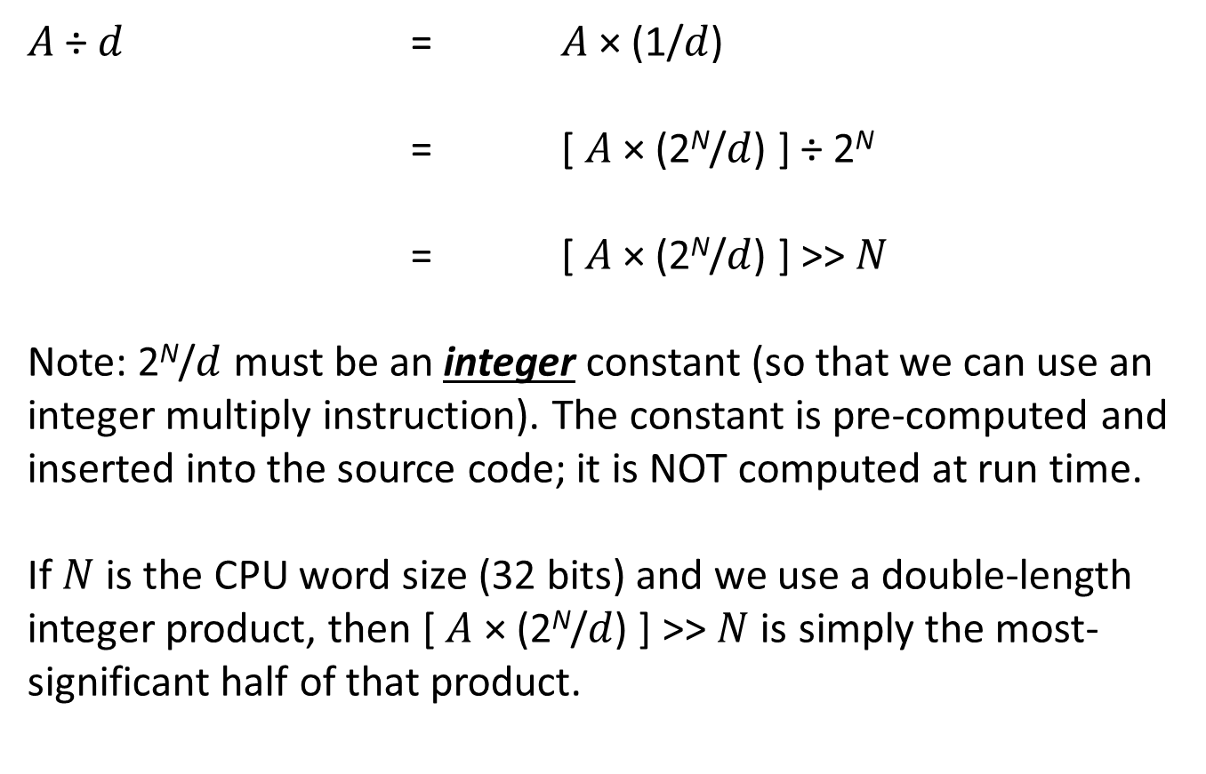
DIVISION BY AN ARBITRARY CONSTANT Using integer multiplication to do integer division
$A$ ÷ $d$ = $A$ × (1/$d$)
= [ $A$ × (2^{N}/$d$) ] ÷ 2^{N}
= [ $A$ × (2^{N}/$d$) ] >> $N$
Note: 2^{N}/$d$ must be an integer constant (so that we can use an integer multiply instruction). The constant is pre-computed and inserted into the source code; it is NOT computed at run time.
If $N$ is the CPU word size (32 bits) and we use a double-length integer product, then [ $A$ × (2^{N}/$d$) ] >> $N$ is simply the most-significant half of that product.

Slide 11
DIVISION BY AN ARBITRARY CONSTANT Example: Divide x by 100, where x is 32 bits wide
Divide 32-bit variable "x" by 100:
Multiplier = 2³²/100 = 42949673 (Rounded)
LDR R0,x
LDR R1,=42949673
SMULL R0,R1,R0,R1 // R1.R0 = 64-bit product
STR R1,y // y = x/100 (approx.)
Example: x = 15340₁₀
product = 15340 × 42949673 = 658847983820₁₀
= 0000 0099 6666 68CC₁₆
quotient = 0000 0099₁₆ = 153₁₀
SDIV may take 12 clock cycles; SMULL takes 1.

Slide 12
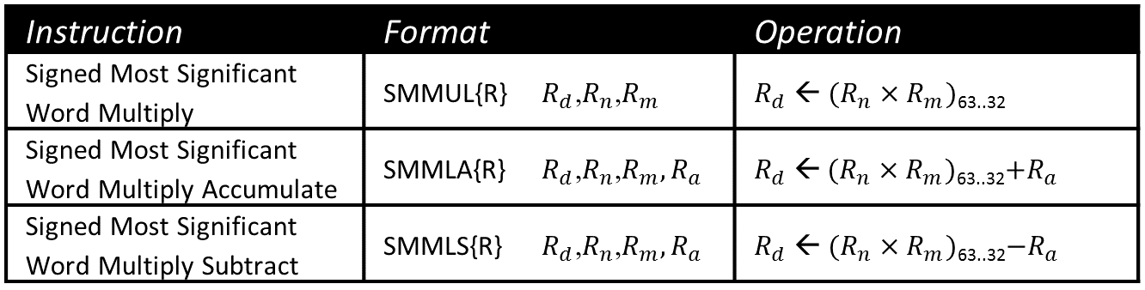
Three New Integer Multiply Instructions

Slide 13
Reciprocal Multiplication with SMMLA & SMMLS
// Divides by +7
LDR R0,dividend
LDR R1,=0x92492493
SMULL R2,R1,R1,R0
ADD R1,R1,R0
ASR R1,R1,2
SUB R0,R1,R0,ASR 31
STR R0,quotient
// Divides by +7
LDR R0,dividend
LDR R1,=0x92492493
SMMLA R1,R1,R0,R0
ASR R1,R1,2
SUB R0,R1,R0,ASR 31
STR R0,quotient
// Divides by -7
LDR R0,dividend
LDR R1,=0x6DB6DB6D
SMULL R2,R1,R1,R0
SUB R1,R1,R0
ASR R1,R1,2
SUB R0,R1,R0,ASR 31
STR R0,quotient
// Divides by -7
LDR R0,dividend
LDR R1,=0x6DB6DB6D
SMMLS R1,R1,R0,R0
ASR R1,R1,2
SUB R0,R1,R0,ASR 31
STR R0,quotient

Slide 14
Remainder vs. Modulus
The C expression, “x % y”, computes the remainder of x divided by y.
The sign of the remainder is always that of the dividend.
However, x MOD y is only defined for y > 0 and is always 0 to y-1.
Thus: +11 % +8 = +3 +11 MOD +8 = +3
–11 % +8 = –3 –11 MOD +8 = +5
+11 % –8 = +3
–11 % –8 = –3
Computing x MOD y:
Find x % y
If negative, add the divisor

Slide 15
REMAINDER WHEN DIVIDING BY 2^{K}
A popular optimization: remainder(x, 2^{k}) → x & (2^{k}–1)
// y = x % 8 ;
LDR R0,x
LDR R1,=8
SDIV R2,R0,R1 // R2 = x/8
MLS R3,R2,R1,R0 // R3 = x – 8*(x/8)
STR R3,y
// y = x & 7 ;
LDR R0,x
AND R1,R0,7
STR R1,y
Example: x = -11
1 | 1 | 1 | 1 | 0 | 1 | 0 | 1
&
0 | 0 | 0 | 0 | 0 | 1 | 1 | 1
LDR, SDIV, MLS may take 15 clock cycles; AND takes 1.
0 | 0 | 0 | 0 | 0 | 1 | 0 | 1
Bitwise-AND computes the modulus, NOT the remainder

Slide 16
CALCULATING TRUE MODULUS WITH AN ARBITRARY DIVISOR
Strategy: Calculate remainder. If it’s negative, add the divisor.
// uint32_t Modulus(int32_t dividend, int32_t divisor) ;
Modulus:
SDIV R2,R0,R1 // R2 = quotient
MLS R3,R1,R2,R0 // R3 = remainder (may be < 0)
AND R2,R1,R3,ASR 31 // R2 = (remainder < 0) ? divisor : 0
ADD R0,R3,R2 // R0 = modulus (adjusted remainder)
BX LR
Note: “R3,ASR 31” will be all 1’s if remainder is negative, else all 0’s.

